Slide 1

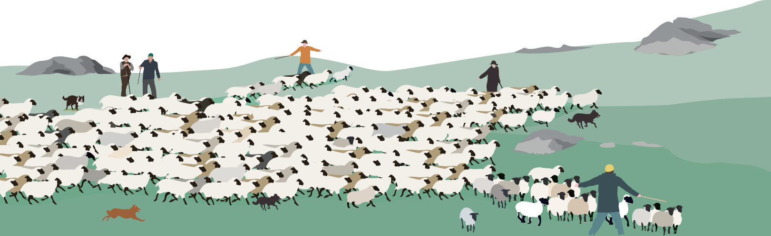
Target Behavior
Cooperative Shepherding

Slide 2
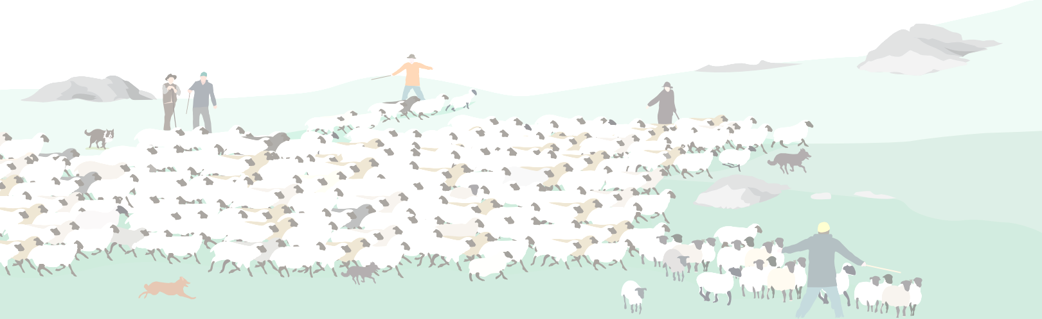
Cooperative Shepherding Scenario
“Move all the sheep to a distinct target region along a specific target trajectory”
Or
“Collect at least N sheep and separate them into M groups of the same size.”
Shepherds
Sheep
Complex Environment

Slide 3



Collective Shepherding Exploration-Exploitation 1

Slide 4
Collective Shepherding Exploration-Exploitation 2
?
target area
?

Slide 5
Integration of various components of collective intelligence
Adaptive self-organization
Collective information processing
Collective decision making and problem solving
Projects RU 1
Behavioral Components
Integration project
Relevant components from other behaviors:
Joint action and multimodal communication
Anticipation, prediction and self-other distinction
Social responsiveness
(Interactive) Perception
...
Collective Shepherding

Slide 6
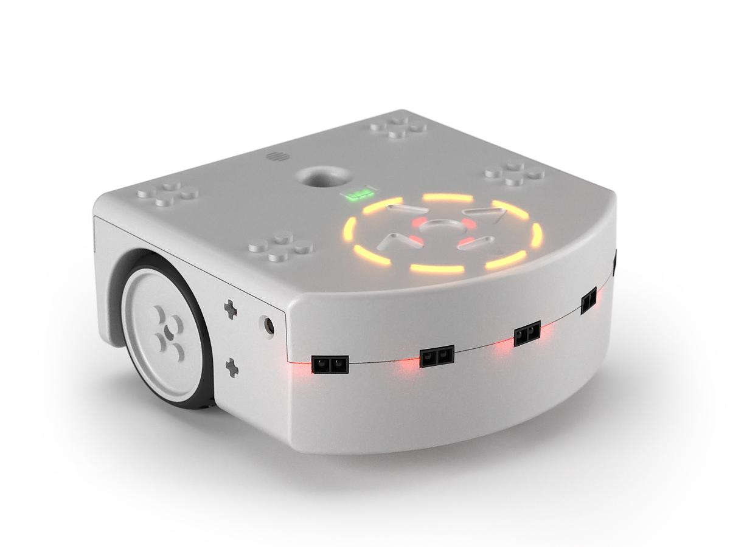
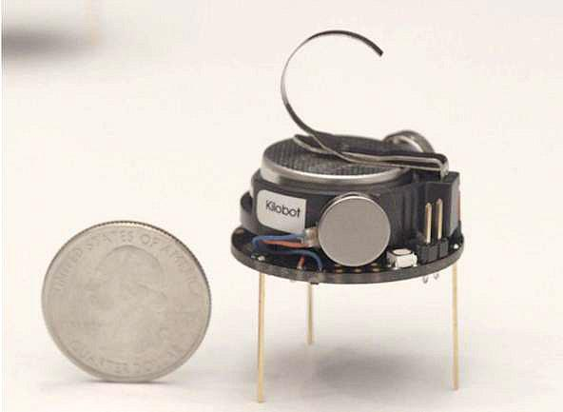
Swarm Robotic Platforms
Kilobots (N > 100)
Thymio II (N=5-20)

Slide 7
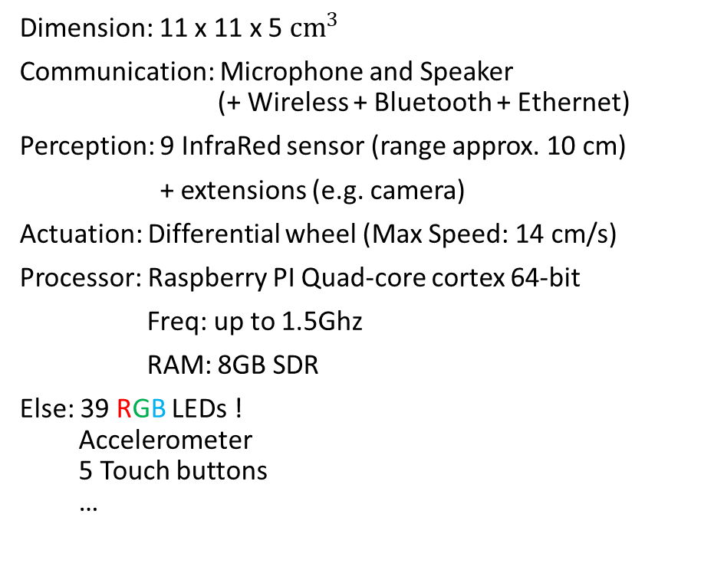
Swarm Robotic Platforms: Specs
Kilobots (N > 100)
Thymio II (N=5-20)
Dimension: Diameter 3.3 cm
Communication: InfraRed (range up to 9 cm)
Neighbor-to-neighbor distance sensing
Perception: Ambient light sensing
Actuation: Vibrator motors (Max speed: 1 cm/s)
Processor: ATMega 328 Microprocessor
Freq: up to 8MHz
RAM: 2Kbytes
Else: 1 RGB LED

Slide 8
Swarm Robotic Platforms
Mohsen Raoufi, David Mezey

Slide 9
Kilobot Platform
Mohsen Raoufi

Slide 10
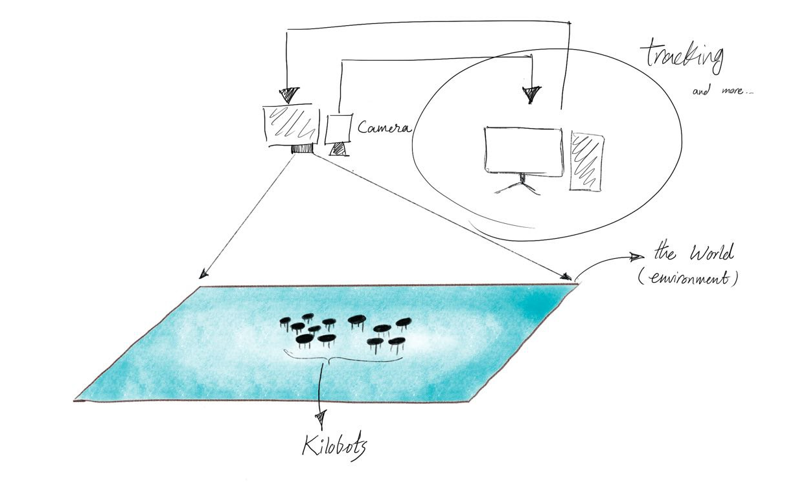
Virtual Reality for Kilobots

Slide 11
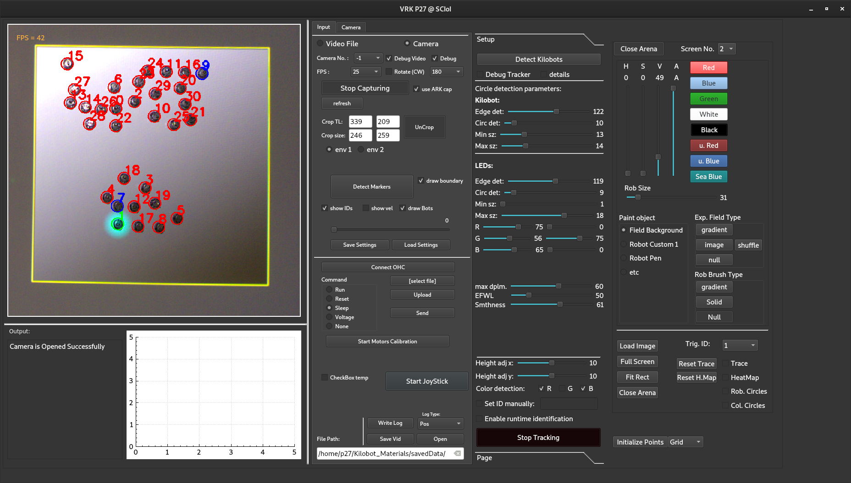

Slide 12
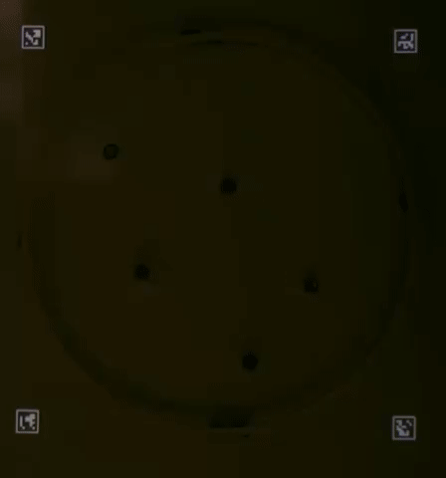
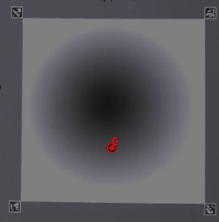
Kilobots-hating-light scenario

Slide 13
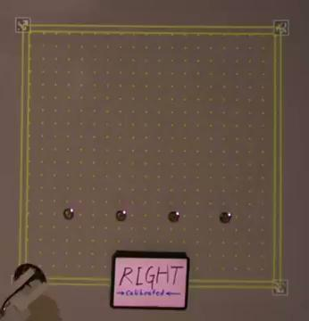


Slide 14
Thymio Platform
David Mezey

Slide 15
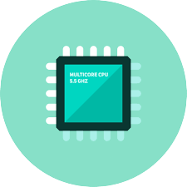
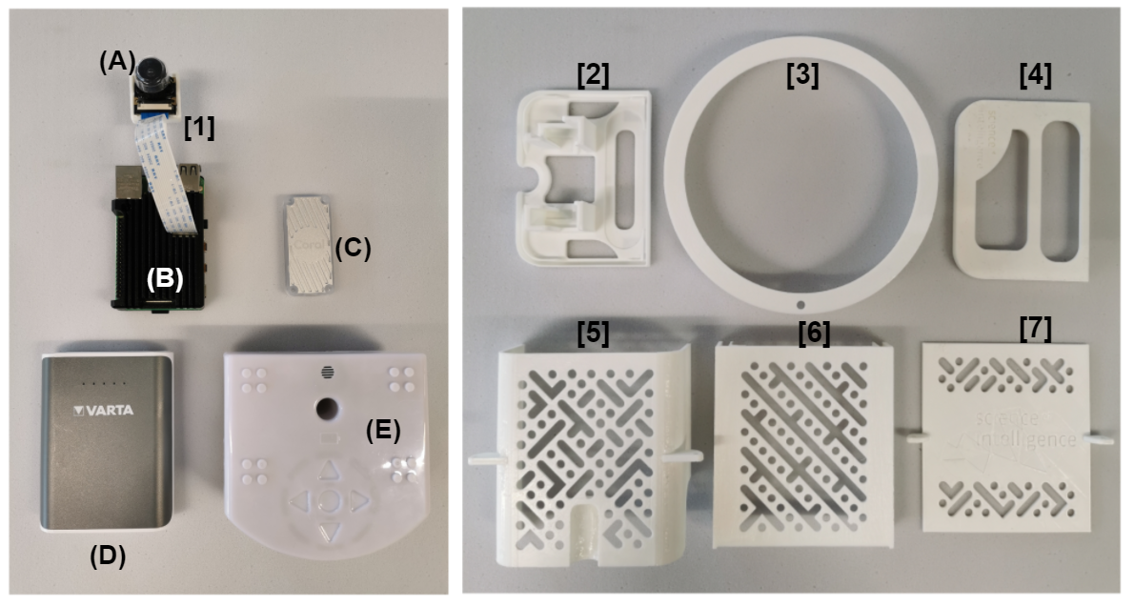
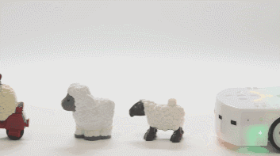
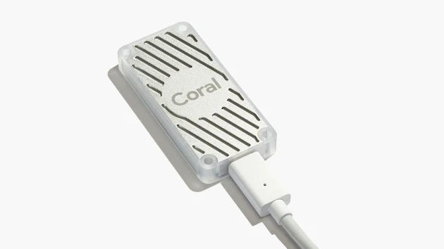
Hardware Stack
(B) Raspberry Pi4
(E) Thymio II
(A)[1] Camera module with fisheye lens
Battery (D)
Google Coral EdgeTPU (C)
Thymio Robot Model [4]
Google Coral EdgeTPU [5]

Slide 16
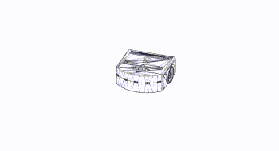
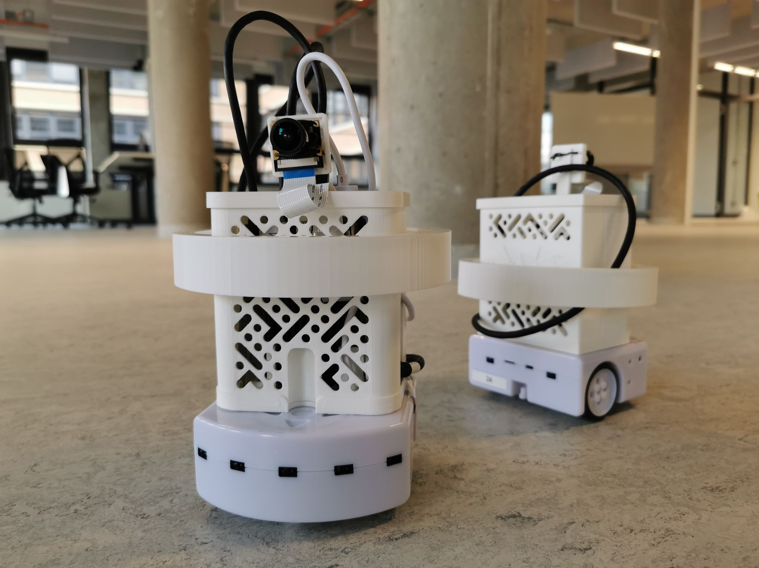


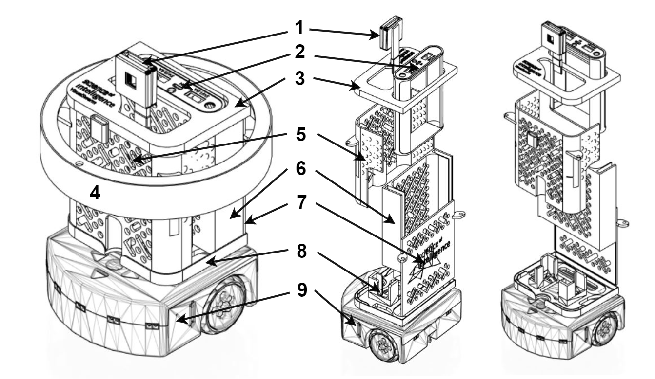
Interact Scaffold
designed in
printed with
Presentation of social cues using Halo element
recognizing fellow robots as targets

Slide 17

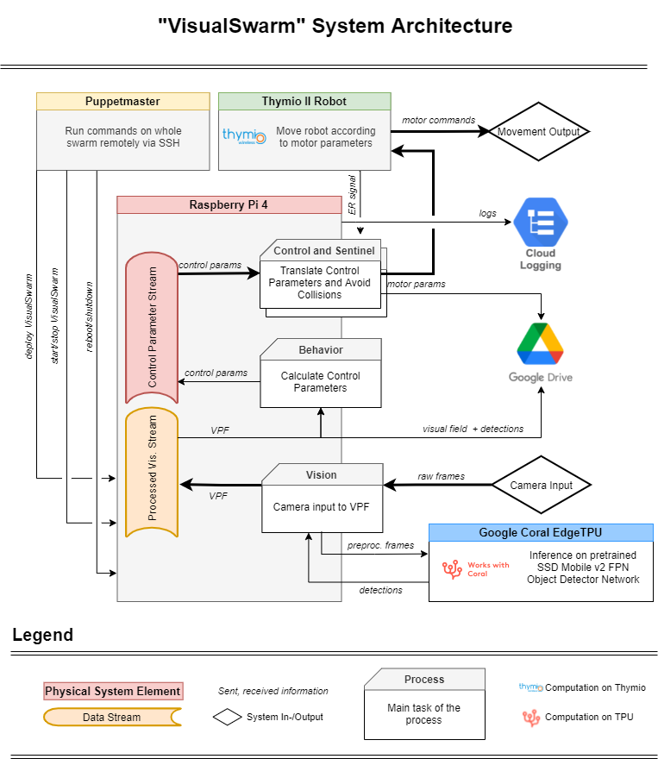
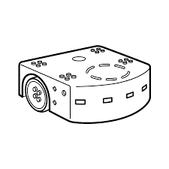
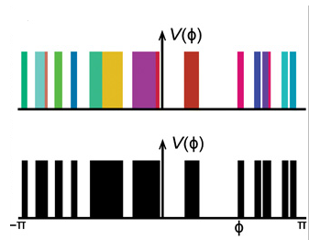
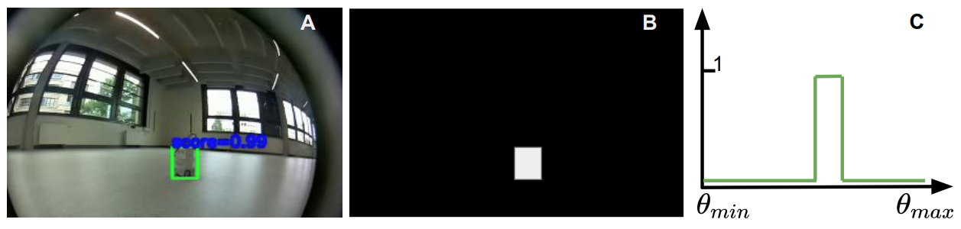
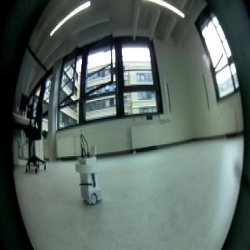
Software Architecture (VSWRM)

Slide 18

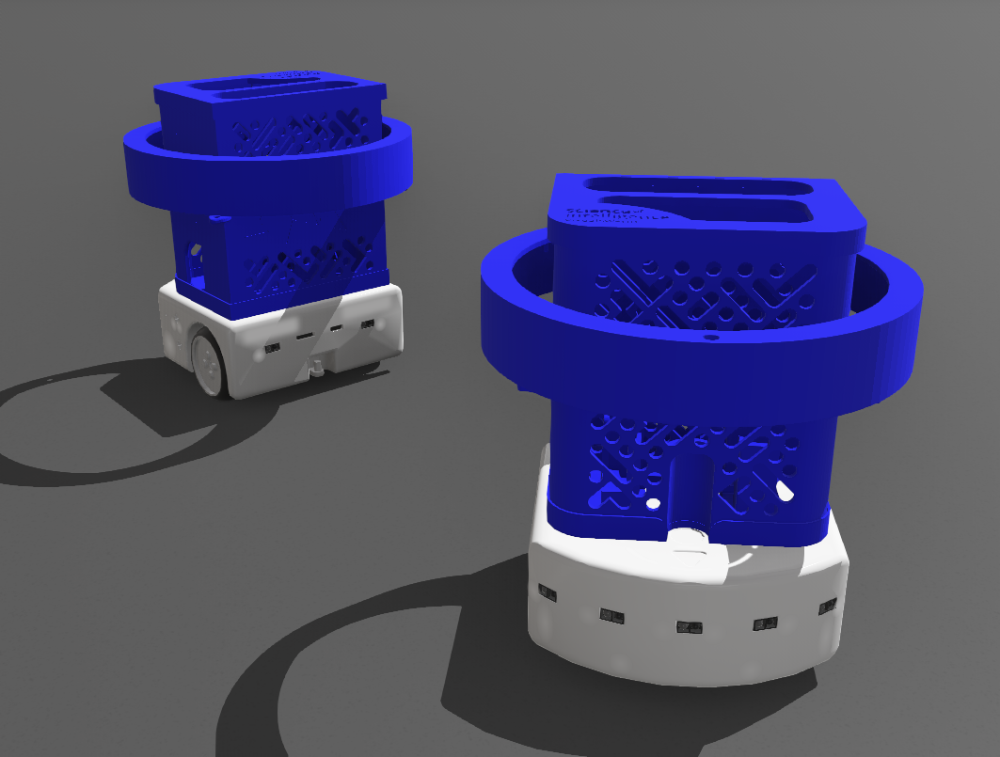

Simulating Real Robots
To initially explore the effects of physical constraints on collective motion before real experiments
Webots simulation environment
VSWRM as controller, 3D replica of Interact Scaffold
created in Webots

Slide 19
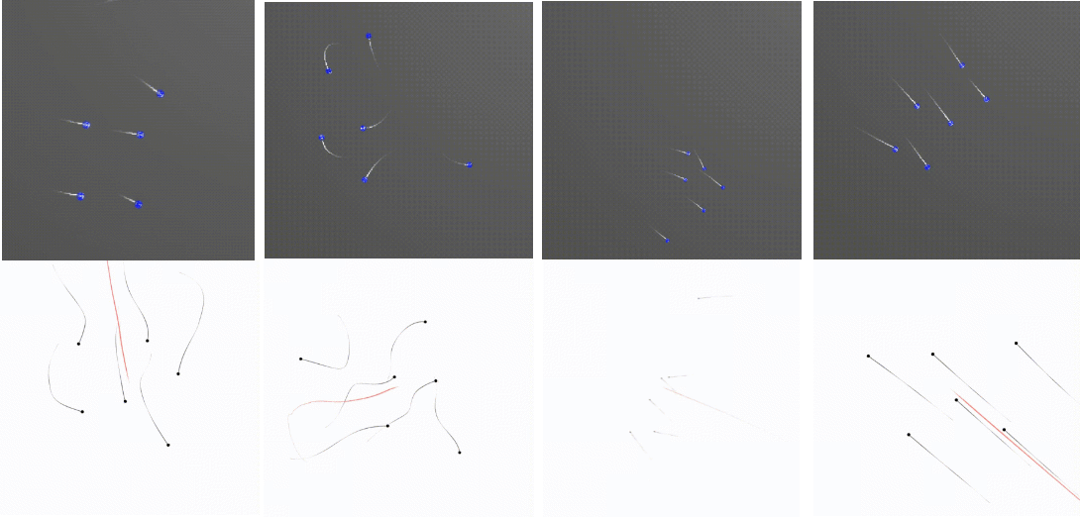
Simulating Real Robots / Reproduce Movement Patterns
pol. swarm
swarm fluid
pol. line
pol. disc
x8
x8
x8
x8
VSWRM
Particle-like
Notes:
With this solution I was able to implement a simple attraction repulsion behavior which serves as the basis of collective motion. The robot follows the object but also try to avoid to get too close to it. The distance in which these forces balance each other is the equilibrium distance, and I also measured how it depends on e.g. alpha 1.
Now as the demonstration of the full stack I would like to show a video

Slide 20

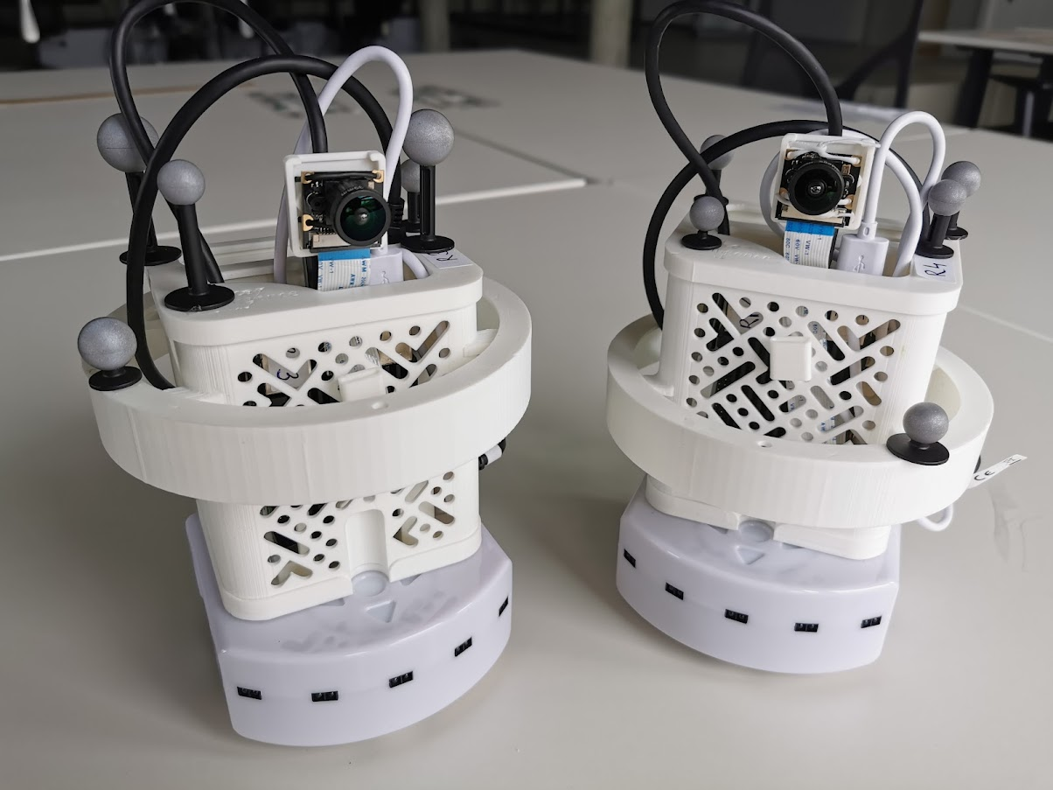
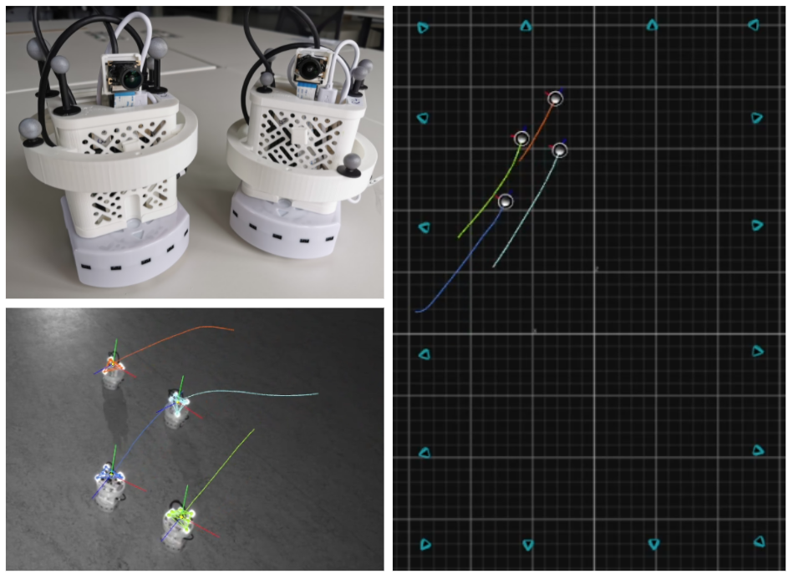
Thymio Platform Motion Tracking
Robots can be tracked with OptiTrack Motion Capture system (16x IR)
Recorded position and orientation data of robots can be then processed and analyzed

Slide 21
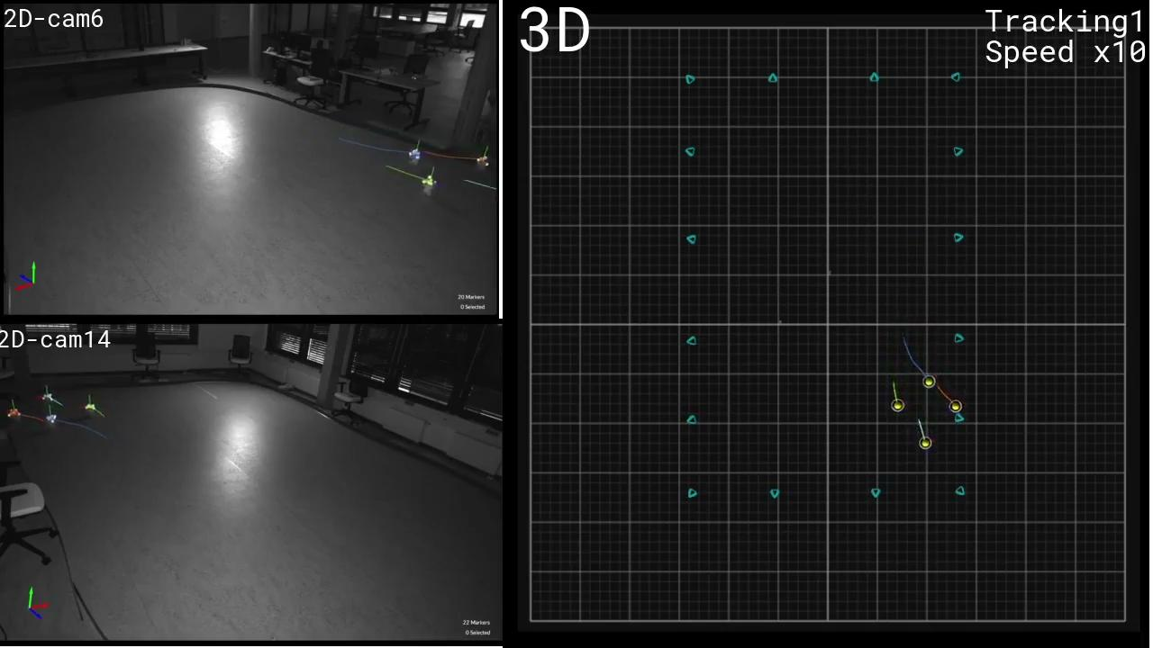
Thymio Platform Motion Tracking
Notes:
You can see the birdseye view on the very right where the previously shown attraction repulsion is clearly visible.
In the middle you see the robot’s perspective and how it tries to keep the target object in focus and in middle of it’s VPF.
Lower left you can see the temporal evolution of the state variables of the agent as well as the processing delay between a raw captured frame and the calculated output. As you can see this is real time as the delay is below 250 ms during all times.
On the top row you can see how the rescources in the “brain” of the robot are changing (i.e. in the raspberry pie)

Slide 22
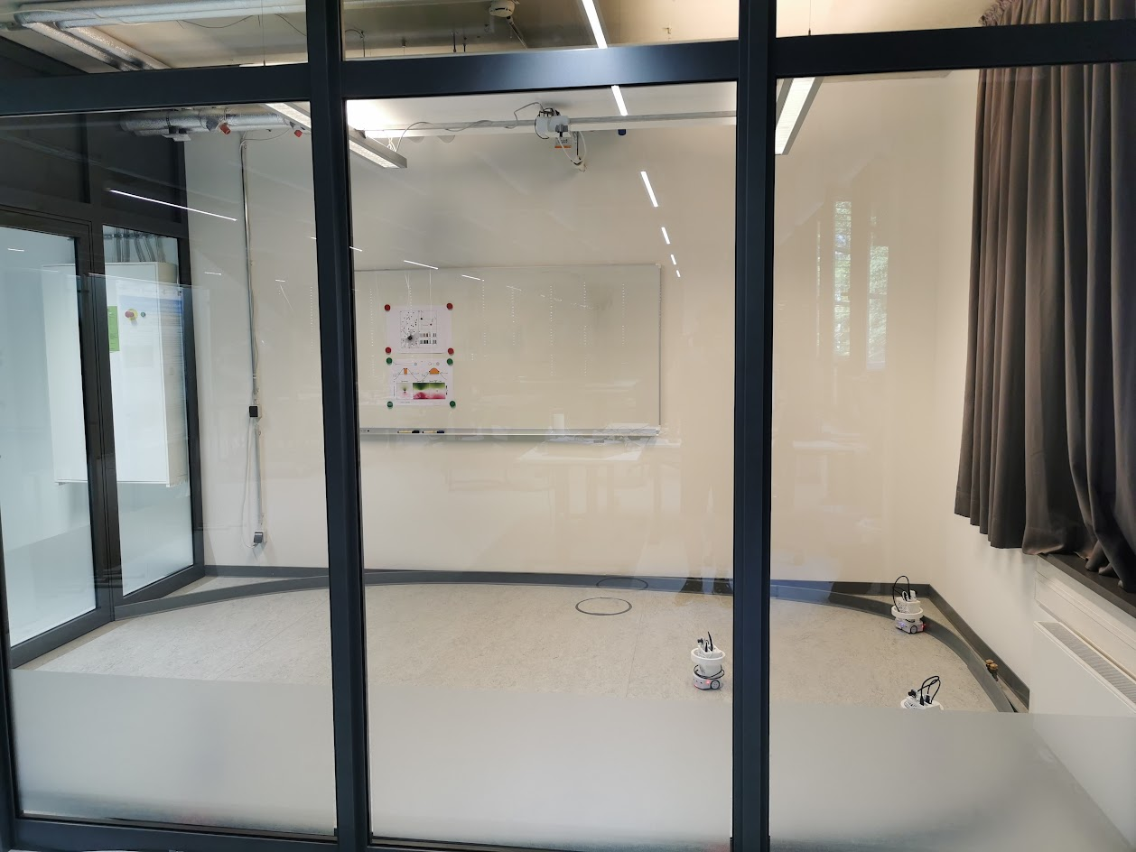
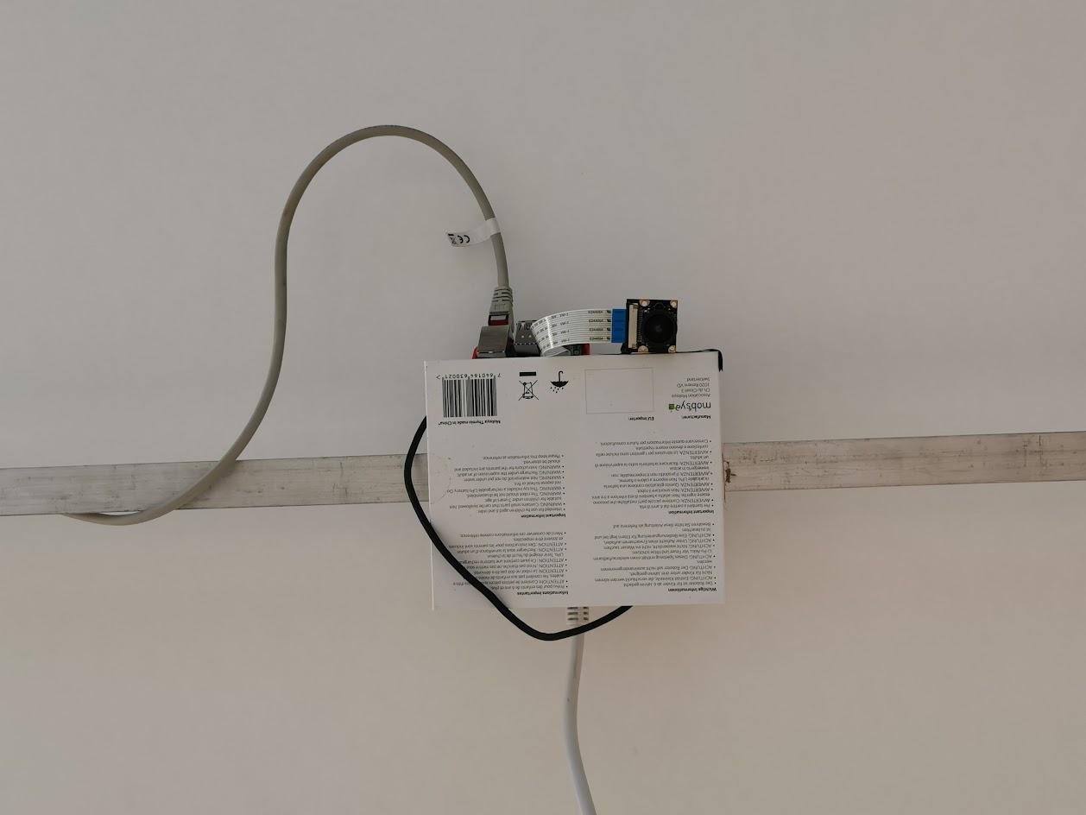
Thymio Fishbowl
Notes:
You can see the birdseye view on the very right where the previously shown attraction repulsion is clearly visible.
In the middle you see the robot’s perspective and how it tries to keep the target object in focus and in middle of it’s VPF.
Lower left you can see the temporal evolution of the state variables of the agent as well as the processing delay between a raw captured frame and the calculated output. As you can see this is real time as the delay is below 250 ms during all times.
On the top row you can see how the rescources in the “brain” of the robot are changing (i.e. in the raspberry pie)

Slide 23
Thymio Fishbowl - Camera Forwarding and RT Status via Grafana
Notes:
You can see the birdseye view on the very right where the previously shown attraction repulsion is clearly visible.
In the middle you see the robot’s perspective and how it tries to keep the target object in focus and in middle of it’s VPF.
Lower left you can see the temporal evolution of the state variables of the agent as well as the processing delay between a raw captured frame and the calculated output. As you can see this is real time as the delay is below 250 ms during all times.
On the top row you can see how the rescources in the “brain” of the robot are changing (i.e. in the raspberry pie)

